Slide 1
ANSI Unmanned Aircraft Systems Standardization Collaborative (UASSC)
Accelerating Standards Development

Slide 2
American National Standards Institute
Standardization Collaboration
One way ANSI coordinates and supports the standardization system is through standards collaboratives and workshops, which:
Bring together the public and private sector in a neutral forum
Identify current and in-development standards, where gaps exists, and recommend solutions
Identify organizations that can perform the needed work
ANSI does NOT write standards
Founded in 1918, ANSI is a private non-profit membership organization whose mission is to enhance U.S. global competitiveness and the American quality of life by promoting, facilitating, and safeguarding the integrity of the U.S. voluntary standardization system.

Slide 3
Standards Developing Organizations (SDOs)
ASTM
International
International
Organization
for
Standardization
RTCA, Inc.
SAE
International
Institute of Electrical and Electronics Engineers
Consumer Technology
Association
Open
Geospatial
Consortium
UL Standards &
Engagement
National Fire Protection Association
American Society of Mechanical Engineers
American Society
of Safety
Professionals
Telecommunications
Industry Assn.

Slide 4
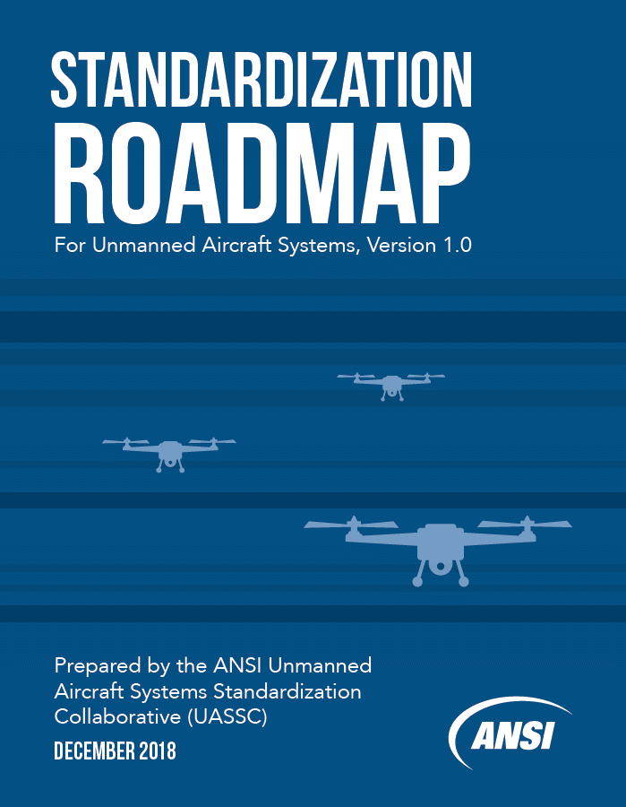
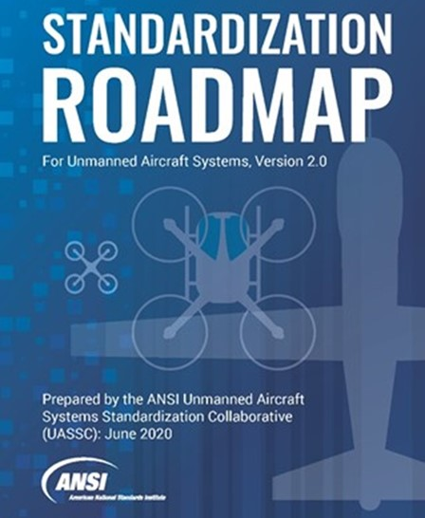
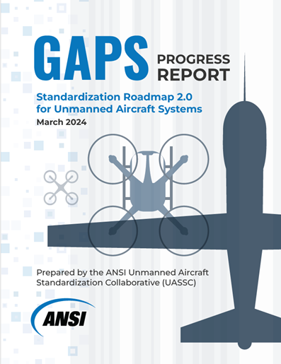
ANSI UASSC Timeline
May 2017
ANSI UAS Standardization Coordination Meeting & Kick Off Meeting
Dec 2018
June 2020
UASSC Standardization Roadmap v1.0 Published
UASSC Standardization Roadmap v2.0 Published
Jun & Dec 2021
Gaps Progress Reports Issued
Jun & Dec 2022
Sept 2019
Launched UASSC Roadmap v2.0
Gaps Progress Reports Issued
Jun & Dec 2022
Gaps Progress Reports Issued
March 2024
Gaps Progress Report Issued
Notes:
A quick snap shot of the work that the UASSC has accomplished over the 7 years since it formed. Two versions of the have been published – the first in 2018, second in 2020. Gaps progress reports on the status of gaps from Roadmap version 2 have been published twice a year.

Slide 5
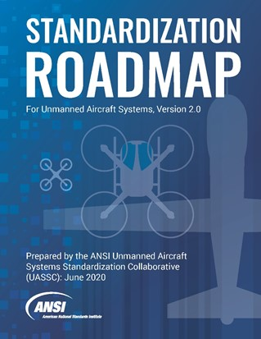
Roadmap v2.0 (2020)
Mission: To coordinate and accelerate the development of the standards and conformity assessment programs needed to facilitate the safe integration of unmanned aircraft systems (UAS) into the national airspace system (NAS) of the United States, with international coordination and adaptability
Technical Areas:
Section 6: Airworthiness Standards
Section 7: Flight Operations Standards: General Concerns and Personnel Training, Qualifications, and Certification Standards
Section 8: Flight Operations Standards: Infrastructure Inspections, Environmental Applications, Commercial Services, and Workplace Safety
Section 9: Flight Operations Standards: Public Safety
Total Gaps: 71
Participation: Approximately 400 individuals from 250 organizations
Notes:
Let’s talk about this years release – It identities standards, codes, guides, and related policies (e.g., NEVI Final Rule) that exist or that are in development
There are four technical areas, which I will show here shortly – and these areas were supported by 3 working groups. About 130 individuals representing 80 organizations supported the EVSP at some capacity. Discussions for cybersecurity stemmed out of WG3 and several new gaps were identified in the weeks before publication. This area is one of the completely new areas in this years document.
Overall there are 37 gaps (and when we say gap we mean that there are no published standard, code or regulation addressing the gap topic area). There are often time “related standards” or standards underway, but if they were not specifically addressing the issue or published, it was deemed a gap. However the existing work is referenced where known.
ANSI has found that inclusion of R&D aspects helps sectors have increased awareness about resources necessary to close gaps so this information was included where possible. R&D needs were only really focused on the gaps and the roadmap doesn’t attempt to specify all R&D needs to EVs overall. 23 gaps did however reference R&D needs.

Slide 6
Roadmap v2 Gaps Breakdown
Priority Chapter | High (0-2 years) | Medium (2-5 years) | Low (5+ years) | Total
Airworthiness (Chap.6) | 17 | 2 | 0 | 19
Flight Operations (Chap.7) | 10 | 3 | 0 | 13
Infrastructure Inspections / Commercial Services (Chap.8) | 9 | 9 | 2 | 20
Public Safety Operations (Chap.9) | 5 | 6 | 1 | 12
Personnel Qualifications (Chap.10) | 6 | 1 | 0 | 7
Total | 47 | 21 | 3 | 71

Slide 7
v2 High Priority Gaps Breakdown
Priority Chapter | High (0-2 years) | Tier 1 (Most Critical) | Tier 2 (Critical) | Tier 3 (Least Critical)
Airworthiness (Chap.6) | 17 | 9 | 4 | 4
Flight Operations (Chap.7) | 10 | 5 | 5 | 0
Infrastructure Inspections / Commercial Services (Chap.8) | 9 | 3 | 1 | 5
Public Safety Operations (Chap.9) | 5 | 2 | 1 | 2
Personnel Qualifications (Chap.10) | 6 | 0 | 4 | 2
Total | 47 | 19 | 15 | 13

Slide 8
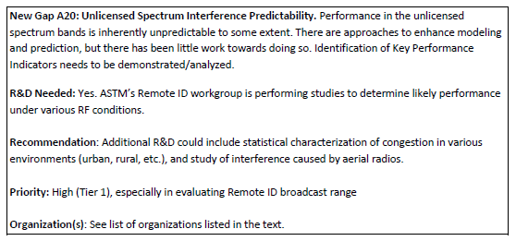
Gap Contents
Background Information: Leading text provides context on the subject area and identifies existing related policies, codes and standards
Short Title & Description: Brief background specific to the gap.
R&D Needs: Describes R&D (if any) to complete to advance knowledge to aid in closing gap.
Recommendation for new or revised standards, codes, guides, priorities, and organizations which could offers solutions
Priority Level: H,M,L with consideration of Criticality, Achievability, Scope (e.g. resources) and Effect (e.g. ROI)
High Priority (a score of 10-12) / 0-2 years
Medium Priority (a score of 7-9) / 2-5 years
Low Priority (a score of 4-6) / 5+ years
Organization(s) who could aid in closing the gap
Slide 8
Notes:
Briefly here – each gap contains background information, title & description, R&D needs and makes a recommendation on what needs to be done as well as organizations who could support the work. Lastly a priority level is also assigned.
Priority levels are determined mostly by Criticality, Achievability, Scope (e.g. resources) and Effect (e.g. ROI). The best way to look at this is really on when you can reasonable expect or need the work to be completed by. As noted here, High priority – within 2 years, Medium, within 5 or low, taking more than 5 years.
In the gaps I have on the following slides – you can see which were high (RED) and medium (Green).

Slide 9
Chapter 6– Airworthiness Standards
6.1. Design and Construction
6.2. UAS System Safety
6.3. Quality Assurance/Quality Control
6.4. Avionics and Subsystems
6.4.1. Command and Control (C2) Link and Communications
6.4.2. Navigation Systems
6.4.3. Systems Performing Detect and Avoid (DAA) Functions
6.4.4. Software Considerations and Approval
6.4.5. Flight Data and Voice Recorders for UAS
6.4.6. Cybersecurity
6.5. Electrical Systems
6.6. Power Sources and Propulsion Systems
6.7. Noise, Emissions, and Fuel Venting
6.8. Mitigation Systems for Various Hazards to UAS
6.9. Parachutes for Small Unmanned Aircraft
6.10. Maintenance and Inspection
6.11. Enterprise Operations: Level of Automation/Autonomy and Artificial Intelligence (AI)
6.12. Blockchain for UAS

Slide 10
Chapters 7 & 10 – Flight Operations Standards: General Concerns and Personnel Training, Qualifications, and Certification Standards
Flight Operations Standards: General Concerns
7.1. Privacy
7.2. Continued Operational Safety (COS)
7.3. Beyond Visual Line of Sight (BVLOS)
7.4. Operations Over People (OOP)
7.5. Weather
7.6. Data Handling and Processing
7.7. UAS Traffic Management (UTM)
7.8. UAS Remote Identification (UAS Remote ID)
7.9. Geo-fencing
7.10. Recreational Operations
7.11. Design and Operation of Aerodrome Facilities for UAS
7.12. UAS Service Suppliers (USS) Process and Quality
Personnel Training, Qualifications, and Certification Standards: General
10.1. Terminology
10.2. Manuals
10.3. UAS Flight Crew
10.4. Additional Crew Members
10.5. Maintenance Technicians
10.6. Compliance/Audit Programs
10.7. Human Factors in UAS Operations

Slide 11
Chapter 8 – Flight Operations Standards: Infrastructure Inspections, Environmental Applications, Commercial Services, and Workplace Safety
8.1. Vertical Infrastructure Inspections
8.1.1. Power Plants and Industrial Process
Plants
8.1.2. Cranes
8.1.3. Building Facades
8.1.4. Low-Rise Residential and
Commercial Buildings
8.1.5. Communications Towers
8.2. Linear Infrastructure Inspections
8.2.1. Bridges
8.2.2. Railroads
8.2.3. Power Transmission Lines,
Structures, and Environs
8.2.4. Implementing UAS for Hydrocarbon
Pipeline Inspections
8.2.5. Implementing UAS in Airport
Operations
8.3. Environmental Applications
8.3.1. Environmental Monitoring
8.3.2. Pesticide Application
8.3.3. Livestock Monitoring and Pasture
Management
8.4. Commercial Services
8.4.1. Commercial Package Delivery via UAS
8.4.2. Commercial Cargo Transport via UAS
8.4.3. Commercial Passenger Air Taxi
Transport via UAS (short-haul flights
carrying few passengers)
8.4.4. Commercial Passenger Transport via
UAS (long-haul flights carrying many
passengers)
8.4.5. Commercial Sensing Services
8.4.6. Use of sUAS for News Gathering
8.5. Workplace Safety

Slide 12
Chapter 9 – Flight Operations Standards: Public Safety
9.1. sUAS for Public Safety Operations
9.2. Hazardous Materials Incident Response
9.3. Transport and Post-Crash Procedures Involving Biohazards
9.4. Forensic Investigations Photogrammetry
9.5. Payload Interface and Control for Public Safety Operations
9.6. Search and Rescue (SAR)
9.6.1. sUAS Infrared (IR) Camera Sensor Capabilities
9.6.2. sUAS Automated Missions during Emergency Response
9.7. Response Robots
9.8. Public Safety Tactical Operations
9.9. UAS Detection and Mitigation
9.9.1. UAS Detection
9.9.2. UAS Mitigation
9.10. UAS for Emergency Management and Disasters
9.11. Standardization of Data Formatting for sUAS Public Safety Operations

Slide 13
v2 High Priority Gaps Tier 1 – Most Critical (19)
Gap A1: UAS Design and Construction (D&C) Standards
Gap A2: UAS System Safety
Gap A6: Alignment in Standards Between Aviation and Cellular Communities
New Gap A20: Unlicensed Spectrum Interference Predictability
Gap A7: UAS Navigational Systems
Gap A8: Protection from Global Navigation Satellite Signals (GNSS) Interference Including Spoofing and Jamming
Gap A9: Detect and Avoid (DAA) Capabilities
Gap A10: Software Considerations and Approval
Gap A12: UAS Cybersecurity
Gap O2: Continued Operational Safety
Gap O3: Beyond Visual Line of Sight (BVLOS)
Gap O4: UAS Operations Over People (OOP)
Gap O8: Remote ID: Direct Broadcast
Gap O9: Remote ID: Network Publishing
New Gap I17: Commercial Passenger Air Taxi Transport via UAS (short-haul flights carrying few passengers and/or cargo)
New Gap I19: Commercial Sensing Services
New Gap I20: Use of sUAS for Newsgathering
New Gap S11: UAS Detection
Gap S9: UAS Mitigation

Slide 14
v2 High Priority Gaps Tier 2 – Critical (15)
Gap A4: Avionics and Subsystems
Gap A16: Mitigation Systems for Various Hazards to UAS
Gap A18: Maintenance and Inspection (M&I) of UAS
Gap A19: Enterprise Operations: Levels of Automation/ Autonomy and Artificial Intelligence (AI)
Gap O5: UAS Operations and Weather
Gap O7: UTM Services Performance Standards
Gap O10: Geo-fence Exchange
New Gap O12: Design and Operation of Aerodrome Facilities for UAS
New Gap O13: UAS Service Suppliers (USS) Process and Quality
Gap I12: Occupational Safety Requirements for UAS Operated in Workplaces
New Gap S13: Data Format for Public Safety sUAS Operations
Gap P2: Manuals
Gap P3: Instructors and Functional Area Qualification
Gap P5: UAS Maintenance Technicians
Gap P9: Human Factors in UAS Operations

Slide 15
v2 High Priority Gaps Tier 3 – Least Critical (13)
Gap A13: Electrical Systems
Gap A14: Power Sources and Propulsion Systems
Gap A15: Noise, Emissions, and Fuel Venting
Gap A17: Parachute or Drag Chute as a Hazard Mitigation System in UAS Operations over People (OOP)
Gap I1: UAS Inspections of Power Plant and Industrial Process Plant Assets
Gap I7: Railroad Inspections: BVLOS Operations
Gap I9: Inspection of Power Transmission Lines, Structures, and Environs Using UAS
Gap I10: Pesticide Application Using UAS
Gap I11: Commercial Package Delivery via UAS
Gap S3: Transport and Post-Crash Procedures Involving Biohazards
Gap S5: Payload Interface and Control for Public Safety Operations
Gap P1: Terminology
Gap P7: Displays and Controls

Slide 16
Steering Committee
Dave Carew, Sikorsky Aircraft Corp.
Madeline Carlson, AIA
Jonathan Daniels, Praxis Aerospace Concepts International
Darshan Divakaran, Airavat, LLC
Ritesh Ghimire, FAA
Brent Klavon, Anra Technologies
Rebecca Morrison, RTCA
Len Morrissey, ASTM International
Kamesh Namuduri, Univ. of North Texas
Steve Palotto, Honeywell Aerospace
Scott Simmons, Open Geospatial Consortium
Jennifer Richter, Akin Gump (CTIA)
David Franks, SAE International
Mark Roboff, SkyThread
Brandon Suarez, Reliable Robotics Corp
Renee Stevens, DHS
Andy Thurling, DroneUp
Bob Voros, Merlin Labs
John Walker, The Padina Group
Rhonda Walthall, Collins Aerospace
Stella Weidner, Boeing
xx

Slide 17
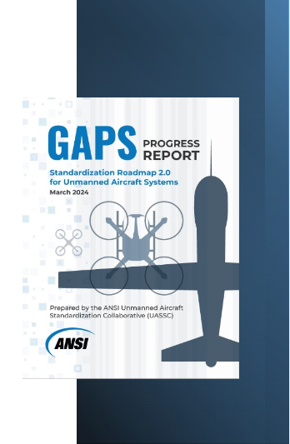
Activity Since Publication of v2
Published 6 semi-annual gaps progress reports tracking activity by SDOs to address roadmap gaps and recommendations
Steering Committee meetings
Roadmap promotion and outreach
Survey on use of roadmap
Developed outline for a roadmap v3 incorporating feedback from survey on use of roadmap and other “parking lot” issues
v3 activities anticipated in 2025

Slide 18
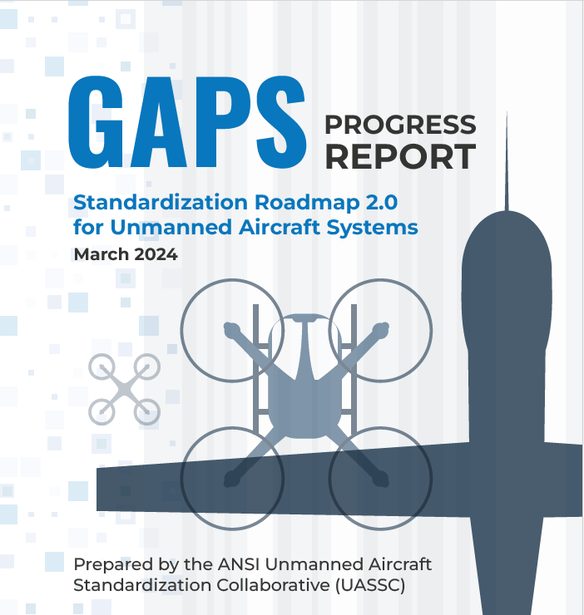
Contact Information
Christine DeJong Bernat Associate Director, Standards Facilitation
1-202-236-7580 (m)
cbernat@ansi.org
uassc@ansi.org
www.ansi.org/uassc

